Slide 1
Named Entity Recognition
Under guidance of
Mr Purusothaman P,
AI Special Lab incharge,
BIT,
Sathy.
Sudarkodi S – 202AD143
Bharathi M – 202AD111
Shanthoshini Devi K – 202AD139
Sukesh N D – 202AD147

Slide 2
Abstract
Named Entity Recognition (NER) is fundamental for some Natural Language
Processing (NLP) errands. Named entity recognition (NER) is the problem of locating and
categorizing important nouns and proper nouns in a text. Past analysts gave an overview of NER
in the measurable AI period, be that as it may, research on NER has as of now changed a ton in
the ongoing ten years. From one viewpoint, increasingly more NER frameworks take profound
learning, move learning, information base, and different strategies. Then again, multilingual and
low asset dialects NER investigates increment quickly. To mirror these changes, we here give
an outline of NER in light of 162 papers of NLP- related gatherings from 1996 to 2017. In this
review, we talk about two fundamental parts of NER research - target dialects and specialized
methodologies with a measurable examination. At long last, we sum up certain ends and
investigate likely future issues in NER research. Named entity recognition (NER) helps you
easily identify the key elements in a text, like names of people, places, brands, monetary values,
and more. Extracting the main entities in a text helps sort unstructured data and detect
Important information, which is crucial if you must deal with large datasets.
Keywords: National Language Processing, POS tagging, Summarization, Statistical Analysis.

Slide 3
Problem Statement Addressed
Named entity recognition (NER)is probably the first step towards information extraction that seeks to locate and classify named entities in text into predefined categories such as the names of persons, organizations, locations, expressions of times, quantities, monetary values, percentages, etc. NER is used in many fields in Natural Language Processing (NLP), and it can help answering many real-world questions. Named Entity Recognition is one of the key entity detection methods in NLP. Named entity recognition is a natural language processing technique that can automatically scan entire articles and pull out some fundamental entities in a text and classify them into predefined categories. In simple words, Named Entity Recognition is the process of detecting the named entities such as person names, location names, company names, etc from the text.

Slide 4
METHODOLOGY PROPOSED:
Entity extraction is a text analysis technique that uses Natural Language Processing (NLP) to automatically pull out specific data from unstructured text and classifies it according to predefined categories. These categories are named entities, the words or phrases that represent a noun. We used Google Scholar to search for articles related to NER and RE and specifically papers used in the context of clinical text. We also checked for publications where the above - mentioned techniques are used in the radiation oncology domain. We discovered that there is very limited work on NER and RE in the radiation oncology domain; however, we did notice that there are a plethora of publications on using NER and RE in the clinical text in general.

Slide 5
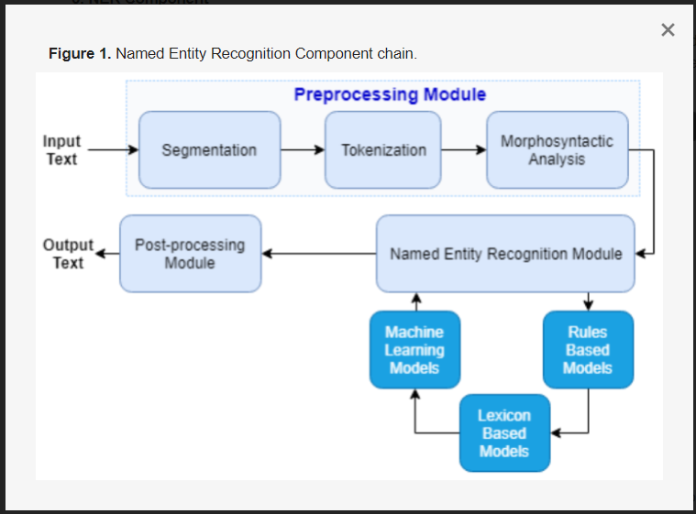
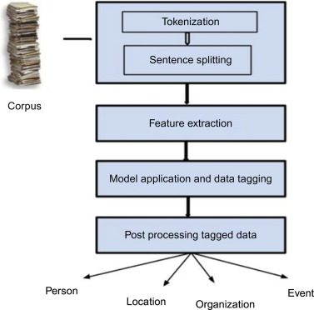
Project Work Plan

Slide 6
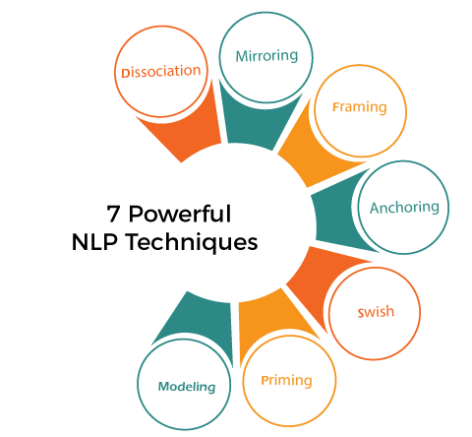
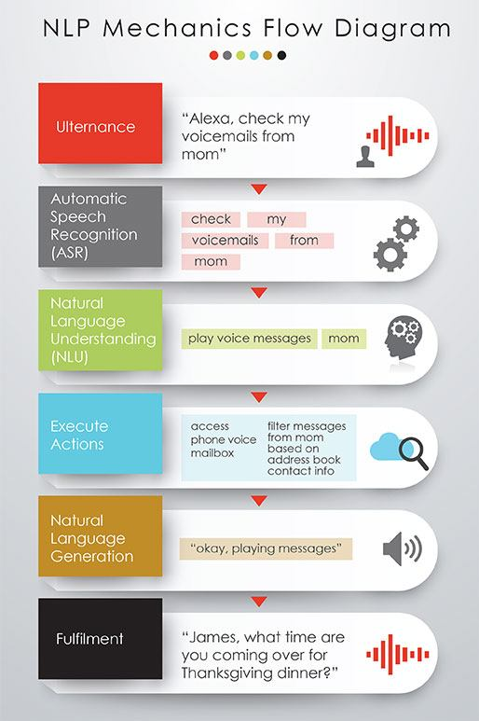
Flow chart

Slide 7
Keyword extraction
keyword extraction is the automated process of extracting the most relevant information from text using AI and machine learning algorithms. With keyword extraction, you can find the most important words and phrases in massive datasets in just seconds. And these words and phrases can provide valuable insights into topics your customers are talking about.
Lemmatization and stemming
Lemmatization and stemming refer to the breakdown, tagging, and restructuring of text data based on either root stem or definition. That might seem like saying the same thing twice, but both sorting processes can lend different valuable data.

Slide 8
Future scope
While it is common for most end-to-end approaches to get some help from external NLP tools for auxiliary tasks, e.g., dependency parsers, it proposed a model to be truly end-to-end with no external help. Problems current systems struggle with are nested entities and inter-sentence relations. Both issues provide ample opportunities for future research. Named entity recognition (NER) helps you easily identify the key elements in a text, like names of people, places, brands, monetary values, and more. Extracting the main entities in a text helps sort unstructured data and detect important information, which is crucial if you have to deal with large datasets.

Slide 9
Conclusion
Named Entity Recognition has been developing continuously for over 15 years. The novel uses it to extract different types of information (name, date, time, location) from the text. In addition, there are more than 20 languages ​​and more than 200 types of entities. Most researchers are interested in specific information on topic types such as news articles, web page information, etc. In today’s web world where a huge amount of information is available as natural language documents, NER has gained a lot of significance. Basic tasks, algorithms used for NER, and major application domains are discussed in the paper. Supervised learning requires a large corpus that has been labeled, Semi-supervised and unsupervised learning allows for rapid recognition of entities without having to have a large labeled corpus.

Slide 10
References
1. Sharnagat, Rahul. "Named Entity Recognition: A Literature Survey." (2014).
2. https://nanonets.com/blog/named-entity-recognition-with-nltk-and-spacy/
3. https://paperswithcode.com/task/named-entity-recognition-ner

